Slide 1
CHAPTER 18
FEATURE EXTRACTION AND
REPRESENTATION

Slide 2
WHAT WILL WE LEARN?
What is feature extraction and why is it a critical step in most computer vision and image processing solutions?
Which types of features can be extracted from an image and how is this usually done?
How are the extracted features usually represented for further processing?

Slide 3
Introduction
Feature extraction: certain features of interest within an image are detected and represented for further processing.
It is a critical step in most computer vision and image processing solutions.
It marks the transition from pictorial to non-pictorial (alphanumerical, usually quantitative) data representation.
The resulting representation can be subsequently used as the input to a number of pattern recognition and classification techniques which will then label, classify, or recognize the semantic contents of the image or its objects.

Slide 4
Introduction
Most techniques presented in this chapter assume that an image has undergone segmentation.
Goal of feature extraction and representation techniques: to convert the segmented objects into representations that better describe their main features and attributes.
There are many ways an image (and its objects) can be represented for image analysis purposes.
In this topic we present several representative techniques for feature extraction using a broad range of image properties.

Slide 5

Feature vectors and vector spaces
A feature vector is a n×1 array that encodes the n features (or measurements) of an image or object.
The array contents may be:
Symbolic
Numerical
Both
The FV is a compact representation of an image (or object), which can be associated with the notion of a feature space, an n-dimensional hyperspace that allows the visualization (for n < 4) and interpretation of the feature vectors' contents, their relative distances, etc.

Slide 6
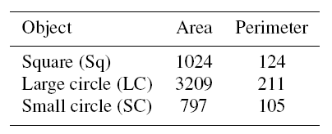
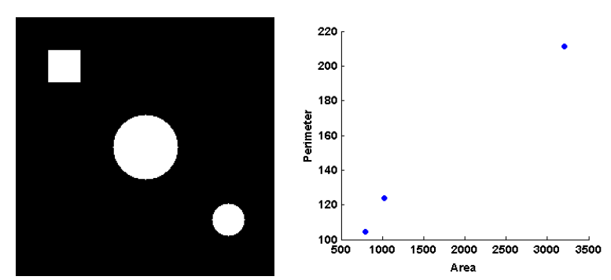
Feature vectors and vector spaces
Example 18.1

Slide 7
Invariance and robustness
It is often required that the features used to represent an image be invariant to rotation, scaling, and translation (RST).
RST invariance ensures that a machine vision system will still be able to recognize objects even when they appear at different size, position within the image, and angle (relative to a horizontal reference).
Clearly this requirement is application-dependent.

Slide 8

Binary object features
Notation: A binary object, in this case, is a connected region within a binary image f(x, y), which will be denoted as O_{i}, i > 0.
In MATLAB: bwlabel
Mathematically:

Slide 9

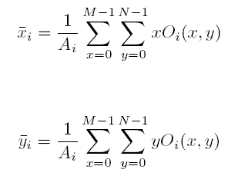
Binary object features
Area:
Centroid:

Slide 10
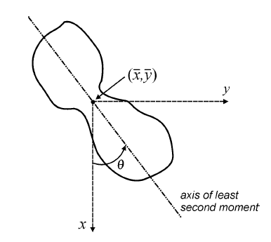
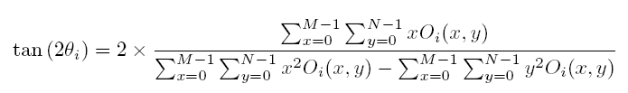
Binary object features
Axis of least second moment:

Slide 11
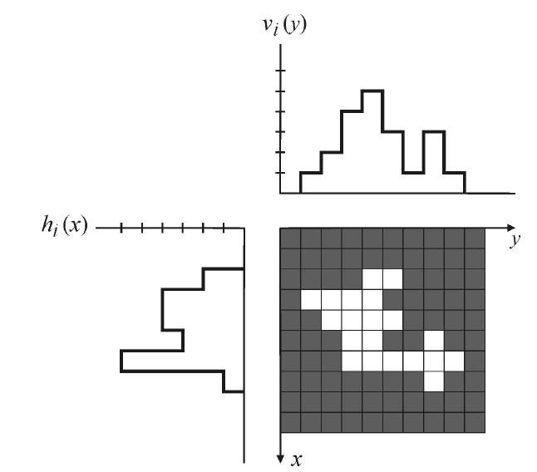
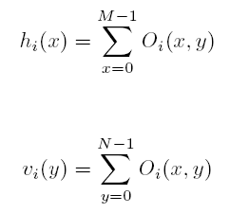
Binary object features
Projections:

Slide 12

Binary object features
Euler number:
E = C - H

Slide 13
Binary object features
Perimeter:
Can be calculated by counting the number of object pixels (whose value is 1) that have one or more background pixels (whose value is 0) as their neighbors.
Alternative method: extract the edge (contour) of the object and then count the number of pixels in the resulting border.
In MATLAB: bwperim

Slide 14

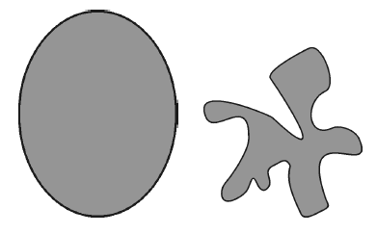
Binary object features
Thinness ratio:
Often used as a measure of roundness.
The higher the thinness ratio (as it approaches 1), the more round the object.
Its inverse is sometimes called irregularity or compactness ratio.

Slide 15
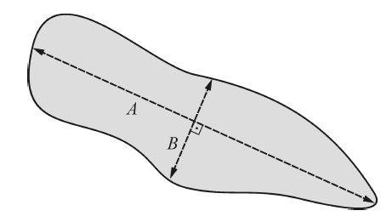
Binary object features
Eccentricity:
The ratio of the major and minor axes of the object (A/B) .

Slide 16

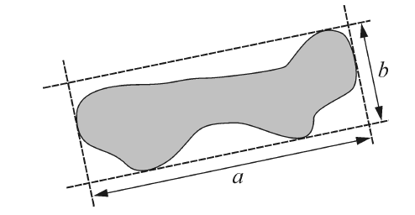
Binary object features
Aspect ratio:
The ratio of the major and minor axes of the object
Elongatedness (a/b):

Slide 17

Binary object features
Moments:
The 2D moment of order (p + q) of a digital image f(x, y) is defined as:

Slide 18
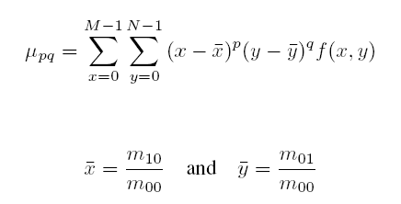
Binary object features
Central moments:
Translation-invariant equivalent of moments.

Slide 19
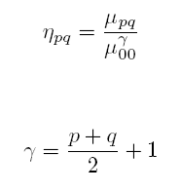
Binary object features
Normalized central moments:

Slide 20
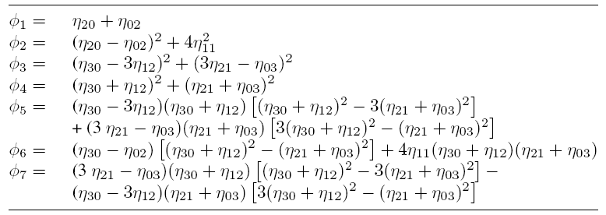
Binary object features
RST-invariant moments [Hu, 1962]:

Slide 21
Binary object features
MATLAB regionprops function
Measures a set of properties for each labeled region L.
One or more properties from the list in Table 18.2 (pp. 457-458) can be specified as parameters.

Slide 22
Boundary descriptors
Contour-based (as opposed to region-based)
Assumptions:
The contour (or boundary) of an object can be represented in a convenient coordinate system (Cartesian, polar, or tangential) and rely exclusively on boundary pixels to describe the region or object.
The pixels belonging to the boundary of the object (or region) can be traced, starting from any background pixel, using an algorithm known as bug tracing.

Slide 23
Boundary descriptors
The bug tracing algorithm:
repeat
as soon as the conceptual bug crosses into a boundary pixel, it makes a left turn and moves to the next pixel;
if that pixel is a boundary pixel, the bug makes another left turn;
otherwise, it turns right;
until the bug is back to the starting point.
As the conceptual bug follows the contour, it builds a list of the coordinates of the boundary pixels being visited.

Slide 24
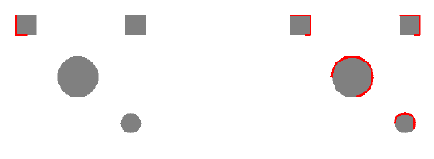
Boundary descriptors
Example 18.2 The bug tracing algorithm in MATLAB (bwtraceboundary):

Slide 25
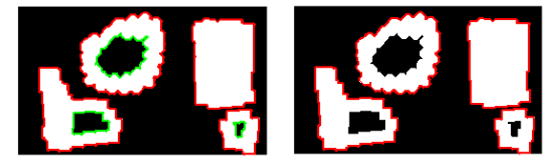
Boundary descriptors
Example 18.3 Boundary tracing in MATLAB (bwboundaries):

Slide 26
Chain code, Freeman code, and shape number
A chain code is a boundary representation technique by which a contour is represented as a sequence of straight-line segments of specified length (usually 1) and direction.
The simplest chain code mechanism (crack code) consists of assigning a number to the direction followed by a bug tracking algorithm as follows: right (0), down (1), left (2), and up (3).
Assuming that the total number of boundary points is p (the perimeter of the contour), the array C, where C(p) = 0, 1, 2, 3, contains the chain code of the boundary

Slide 27
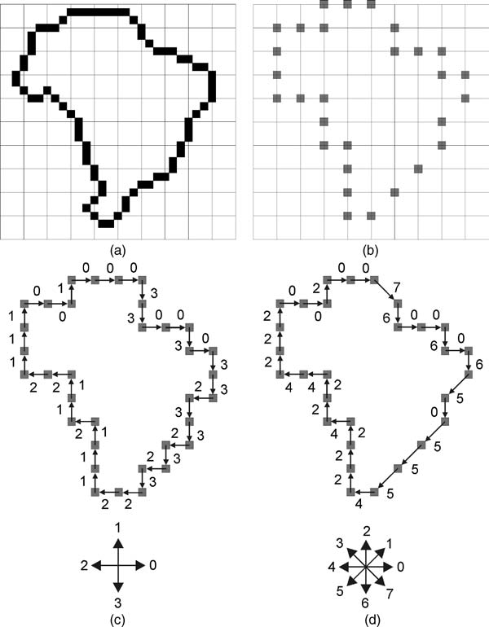
Chain code, Freeman code, and shape number
Freeman code: a modified version of the basic chain code, using eight directions instead of four.
Example:

Slide 28
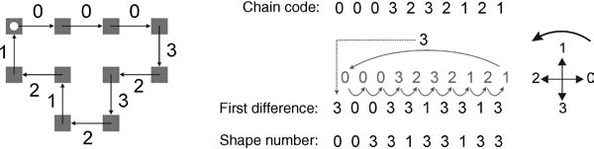
Chain code, Freeman code, and shape number
Shape number: normalized, rotation-invariant, equivalent of the chain code.

Slide 29
Signatures
1D representation of a boundary, usually obtained by representing the boundary in a polar coordinate system and computing the distance r between each pixel along the boundary and the centroid of the region, and the angle θ subtended between a straight line connecting the boundary pixel to the centroid and a horizontal reference.
The resulting plot provides a concise representation of the boundary, that is RT-invariant, but not scaling-invariant.

Slide 30
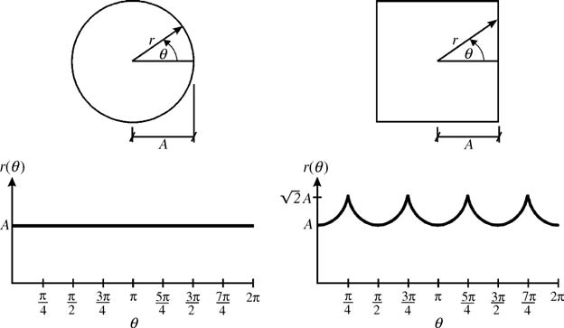
Signatures
Examples:

Slide 31
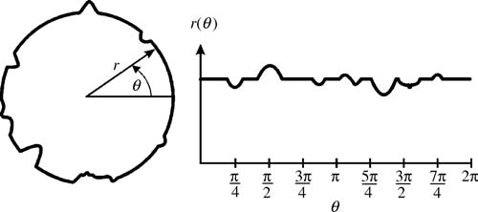
Signatures
Effects of noise:

Slide 32
Fourier descriptors
Basic idea: to traverse the pixels belonging to a boundary, starting from an arbitrary point, and record their coordinates.
Each value in the resulting list of coordinate pairs (x₀ ,y₀), (x₁ ,y₁), …,
(x_{k-1} ,y_{k-1}) is then interpreted as a complex number x_{k} + j y_{k}, for k = 0, 1, …, K-1.
The Discrete Fourier Transform (DFT) of this list of complex numbers is the Fourier descriptor of the boundary.
The inverse DFT restores the original boundary.

Slide 33
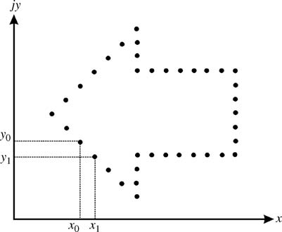
Fourier descriptors
Basic idea

Slide 34
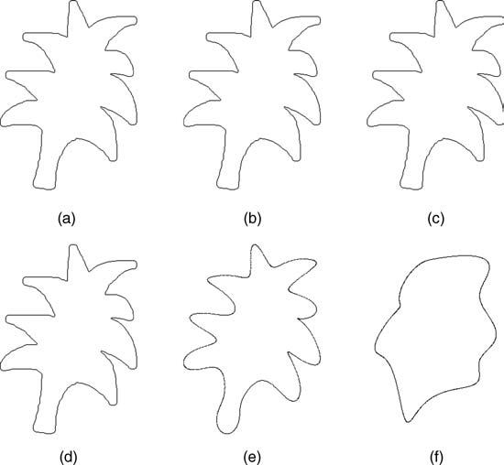
Fourier descriptors
Interesting property: contour can be encoded using very few values (coefficients).
Example 18.4:

Slide 35


Histogram-based features
Average gray value:

Slide 36
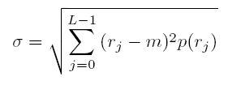

Histogram-based features
Standard deviation:
Skew:

Slide 37


Histogram-based features
Energy:
Entropy:

Slide 38
Texture features
Texture can be a powerful descriptor of an image (or one of its regions).
Although there is not a universally agreed upon definition of texture, image processing techniques usually associate the notion of texture with image (or region) properties such as smoothness (or its opposite, roughness), coarseness, and regularity.

Slide 39
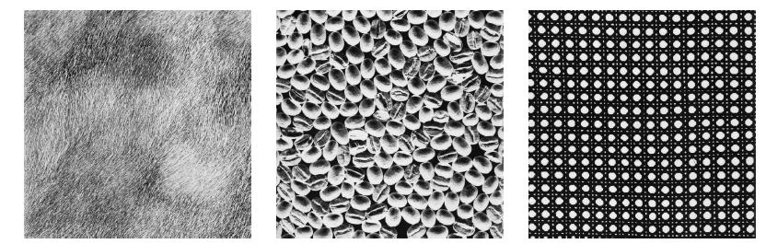
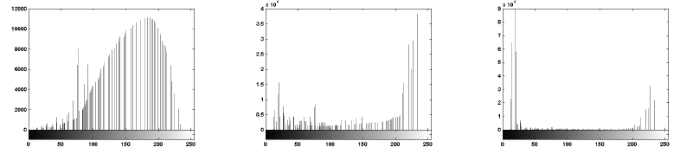
Texture features
Texture – examples:

Slide 40

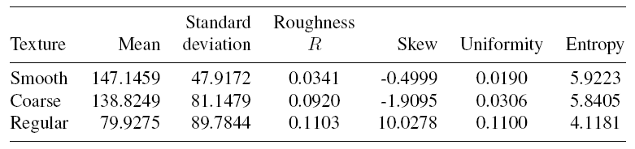
Texture features
Texture – Example 18.5:

Slide 41

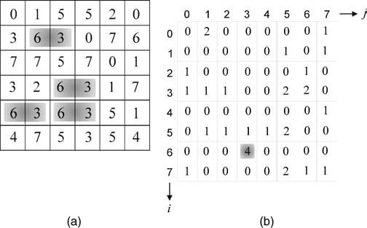
Texture features
Gray-level co-occurrence matrix (GLCM)
Displacement vector:
Example [d=(0,1)]:

Slide 42
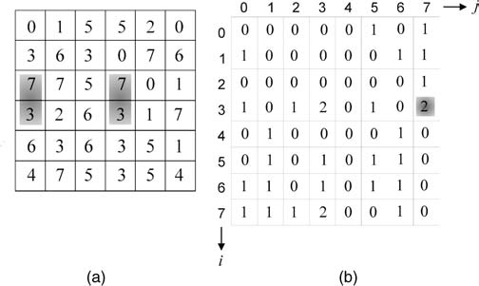
Texture features
Gray-level co-occurrence matrix (GLCM)
Another example [d=(1,0)]:

Slide 43
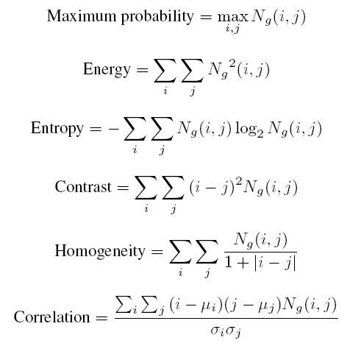

Texture features
Normalized GLCM and associated features:

Slide 44
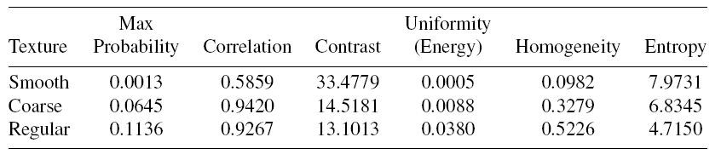
Texture features
Texture descriptors based on GLCM Example 18.6:

Slide 45
Hands-on
Tutorial 18.1: Feature extraction and representation (page 470)

